Slide 1
Weakly Supervised Learning of Rigid 3D Scene Flow
Presented By: Rafid Abyaad and Wenliang Peng
Supervised By : Yujin Chen

Slide 2
Outline
Scene flow estimation task
Related works
Contributions of the base paper
Model Overview
Loss formulations
Inference and Metrics
Experimental results
Ideas for improvement

Slide 3
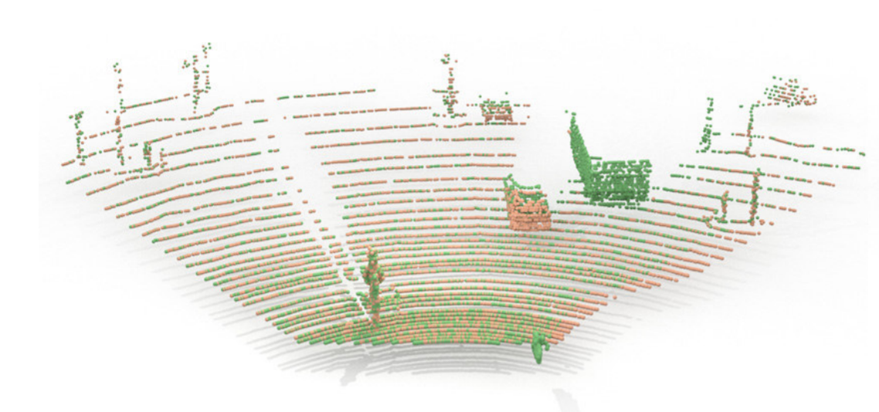
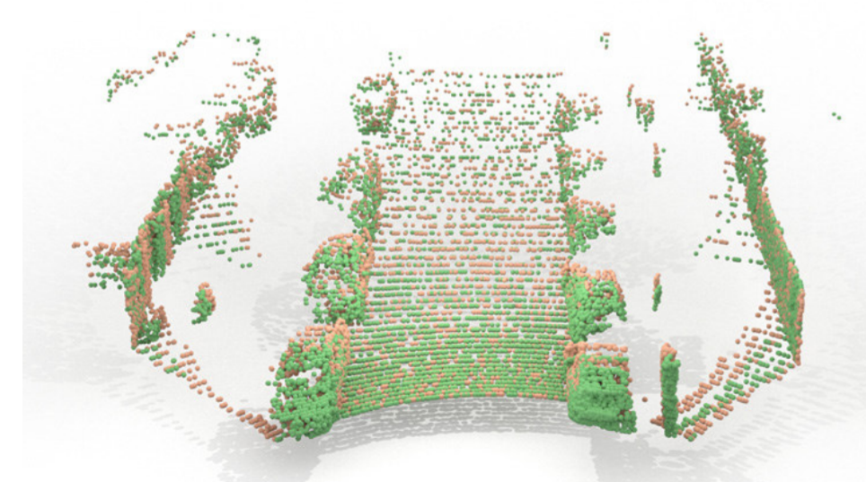
Scene Flow Estimation
3D scenes are a collection of agents moving as rigid bodies.
Generalization of 2D optical flow.
Semi-dense/Dense 3D motion field that moves with respect to a camera.
Task: Estimate the 3D flow vectors for consecutive 3D point clouds.

Slide 4
Related Works
Representing dynamics via free form velocity fields[1][2][3].
Unconstrained per point flow may lead to non-viable results.
Requires dense supervision.
Expensive to acquire and prone to errors.
Simulated data introduces domain gap.
Unsupervised approaches[4][5[6].
Do not achieve competitive performance.
Rodrigo L Carceroni and Kiriakos N Kutulakos. Multi-view scene capture by surfel sampling: From video streams to non-rigid 3d motion, shape and reflectance. International Journal of Computer Vision, 49(2-3):175–214, 2002.
N. Mayer, E. Ilg, P. Häusser, P. Fischer, D. Cremers, A. Dosovitskiy, and T. Brox. A large dataset to train convolutional networks for disparity, optical flow, and scene flow estimation. In IEEE International Conference on Computer Vision and Pattern Recognition (CVPR), 2016. arXiv:1512.02134
Zirui Wang, Shuda Li, Henry Howard-Jenkins, Victor Adrian Prisacariu, and Min Chen. Flownet3d++: Geometric losses for deep scene flow estimation. arXiv preprint arXiv:1912.01438, 2019.
Himangi Mittal, Brian Okorn, and David Held. Just go with the flow: Self-supervised scene flow estimation. arXiv preprint arXiv:1912.00497, 2019.
Wenxuan Wu, Zhiyuan Wang, Zhuwen Li, Wei Liu, and Li Fuxin. Pointpwc-net: A coarse-to-fine network for supervised and self-supervised scene flow estimation on 3d point clouds. arXiv preprint arXiv:1911.12408, 2019.
Ivan Tishchenko, Sandro Lombardi, Martin R Oswald, and Marc Pollefeys. Self-supervised learning of non-rigid residual flow and ego-motion. arXiv preprint arXiv:2009.10467, 2020.

Slide 5
Contributions of the paper
Proposes a weakly supervised approach.
Makes use of background masks and ego-motion to train.
Object level flow learning.
Flexible and adaptive backbone.
Best of both supervised and unsupervised approaches.

Slide 6
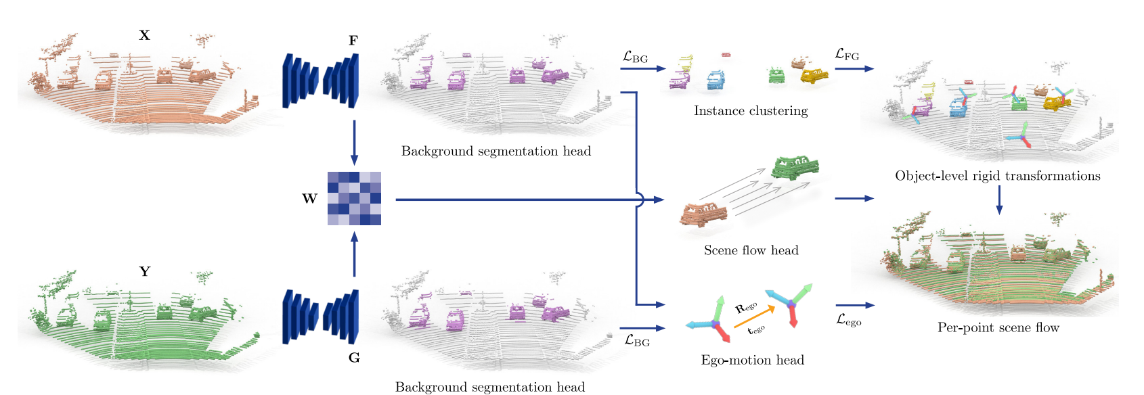
Model Overview

Slide 7
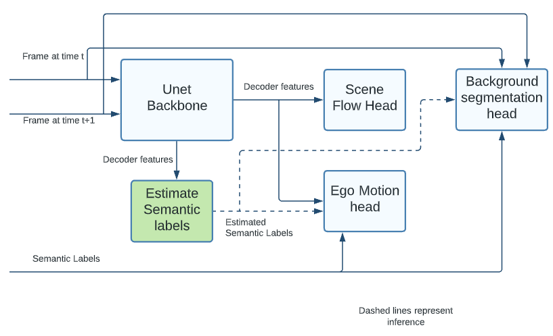
Module Overview

Slide 8
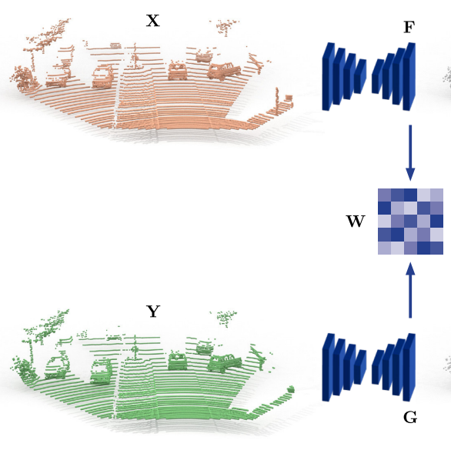
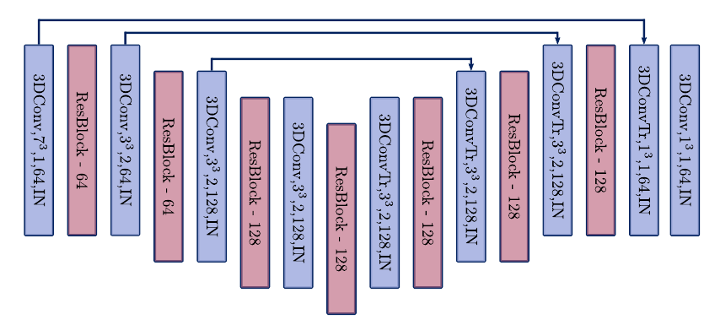
Backbone
U-Net encoder-decoder architecture with skip connections.
Input: sparsely voxelized point cloud
Output: Per point latent features
Has a sub-module to estimate semantic labels

Slide 9
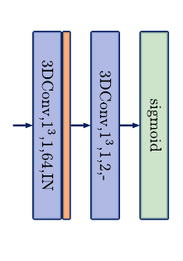

Heads
Background segmentation head
Foreground and background segmentation
Takes latent features as input
Outputs per-point foreground probability.
Ego-motion head
Takes latent features and background points as input.
Outputs affinity matrix to describe similarity of background points.

Slide 10
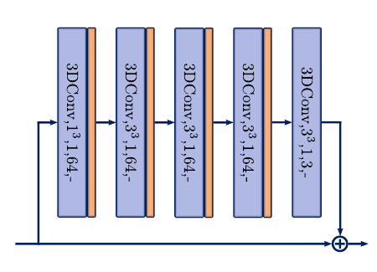

Heads (contd.)
Scene flow head
Takes latent features as input.
Finds correspondence between two frames.
Computes initial flow estimates :
Refines the initial estimations using sparse convolutions in a residual connection.

Slide 11


Loss Formulation
Loss formulated as a composition of
BG segmentation loss
Ego-motion loss
FG rigidity loss
Background segmentation loss
Mean BCE loss of two frames.
BCE loss calculated from ground truth binary masks and per point foreground probability.

Slide 12

Loss Formulation (contd.)
Ego-motion loss
Randomly sample 1024 background points from both frames.
Calculate soft correspondence using Sinkhorn algorithm.
Ego motion recovered using Kabsch algorithm.
Ego-motion loss is the L1 loss between estimated ego motion and ground truth.
Additionally adds a regularized loss for stable training.

Slide 13

Loss formulation (contd.)
Foreground rigidity loss
Cluster 3D coordinates of foreground.
The loss encourages that the flow vectors of each cluster can be approximated using a transformation.
Complemented with two-way Chamfer distance for all FG points.
Final loss is a weighted sum of these losses.

Slide 14
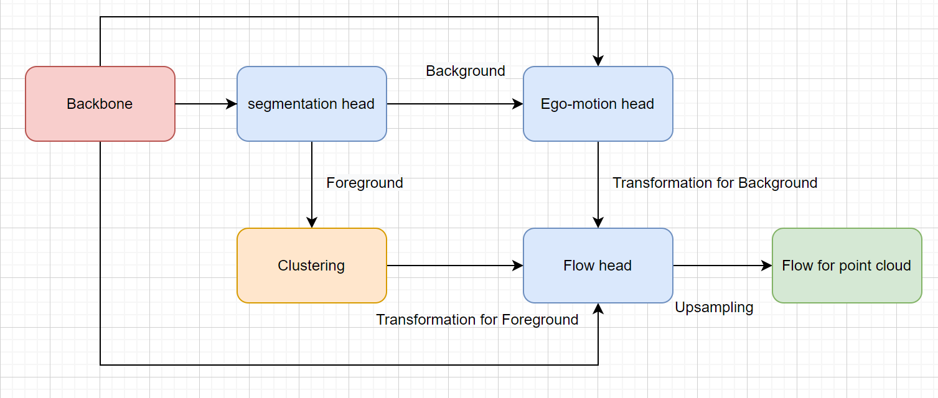
Inference

Slide 15
Metrics
EPE: mean end-point-error
Acc3DS: strict accuracy (EPE < 0.05 m or relative error < 0.05)
Acc3DR: relaxed accuracy (EPE < 0.1 m or relative error < 0.1)
Outlier: (EPE > 0.3 m or relative error > 0.1)
relative error: Ratio of EPE to GT flow

Slide 16
Setup for all Experiments
Hardware: T4 GPU on GCP and Colab
Dataset for training and validation: 5% of original training and validation dataset(semanticKITTI)
Dataset for test: lidarKITTI dataset
Batch size: 6
Learning rate: 0.001
Scheduler: ExponentialLR
Epochs: 40
Tensorboard visualization: every 20 batches

Slide 17
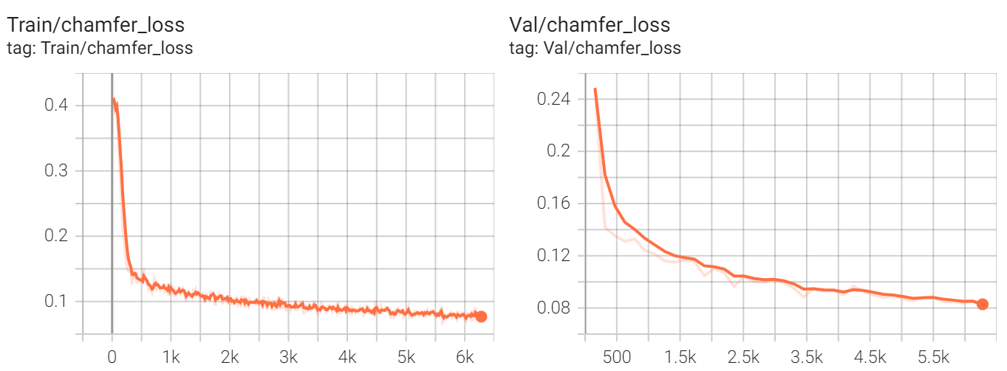
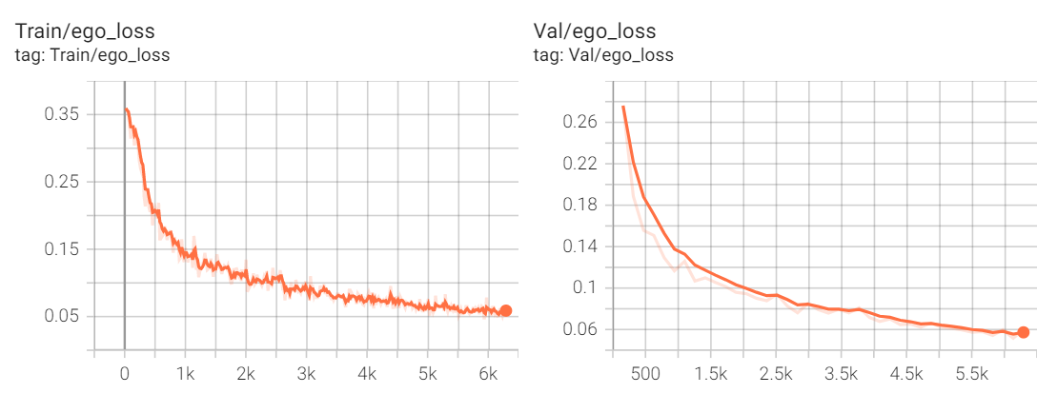
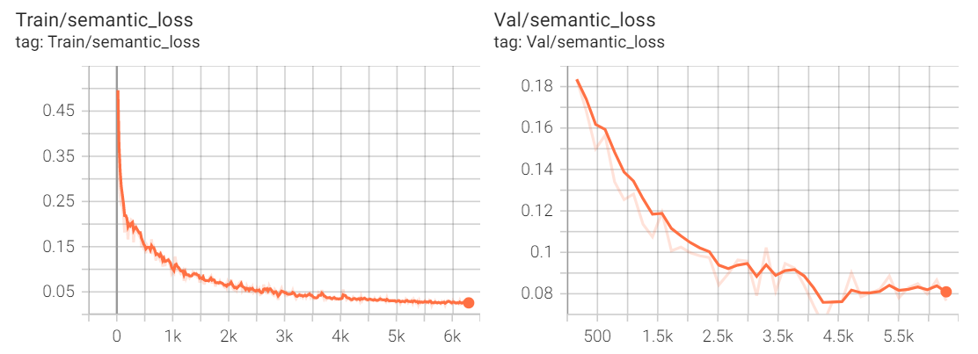
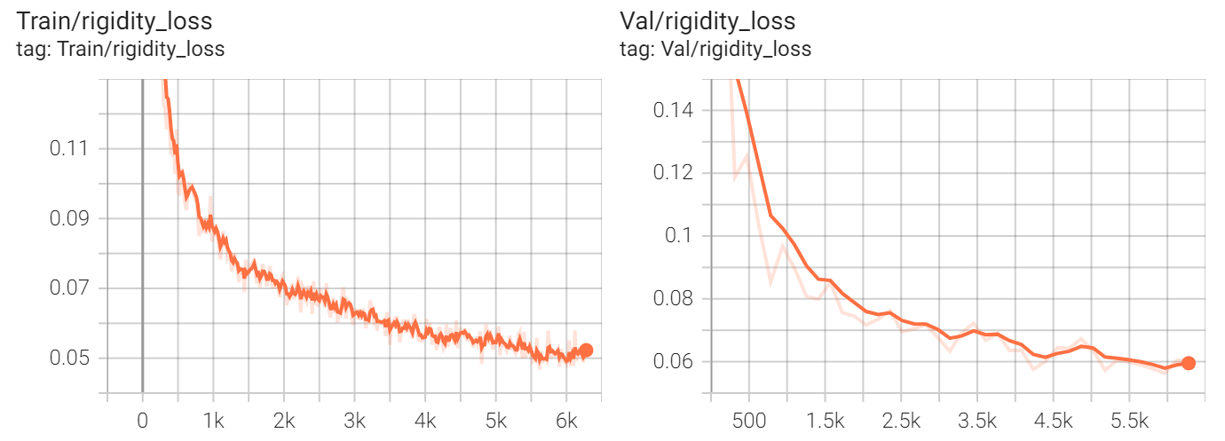
Baseline Result for Training

Slide 18
Baseline Result for Testing
lidarKITTI dataset
EPE: 0.159
Acc3DS: 0.638
Acc3DR: 0.773
Outlier: 0.417

Slide 19
Ideas for further improvement
Looking closely into scene flow head refinement module and exploring other algorithms for smoothing out the noisy initial vector field.
Exploring algorithms for the correspondence point.
Simplifying the complex loss function of the algorithm while ensuring competitive performance.

Slide 20
Thank you

Slide 21
References
Rodrigo L Carceroni and Kiriakos N Kutulakos. Multi-view scene capture by surfel sampling: From video streams to non-rigid 3d motion, shape and reflectance. International Journal of Computer Vision, 49(2-3):175–214, 2002.
N. Mayer, E. Ilg, P. Häusser, P. Fischer, D. Cremers, A. Dosovitskiy, and T. Brox. A large dataset to train convolutional networks for disparity, optical flow, and scene flow estimation. In IEEE International Conference on Computer Vision and Pattern Recognition (CVPR), 2016. arXiv:1512.02134
Zirui Wang, Shuda Li, Henry Howard-Jenkins, Victor Adrian Prisacariu, and Min Chen. Flownet3d++: Geometric losses for deep scene flow estimation. arXiv preprint arXiv:1912.01438, 2019.
Himangi Mittal, Brian Okorn, and David Held. Just go with the flow: Self-supervised scene flow estimation. arXiv preprint arXiv:1912.00497, 2019.
Wenxuan Wu, Zhiyuan Wang, Zhuwen Li, Wei Liu, and Li Fuxin. Pointpwc-net: A coarse-to-fine network for supervised and self-supervised scene flow estimation on 3d point clouds. arXiv preprint arXiv:1911.12408, 2019.
Ivan Tishchenko, Sandro Lombardi, Martin R Oswald, and Marc Pollefeys. Self-supervised learning of non-rigid residual flow and ego-motion. arXiv preprint arXiv:2009.10467, 2020.

